Slide 1
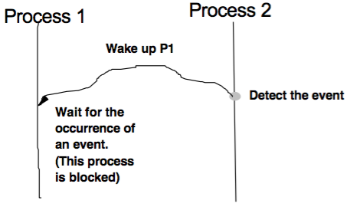
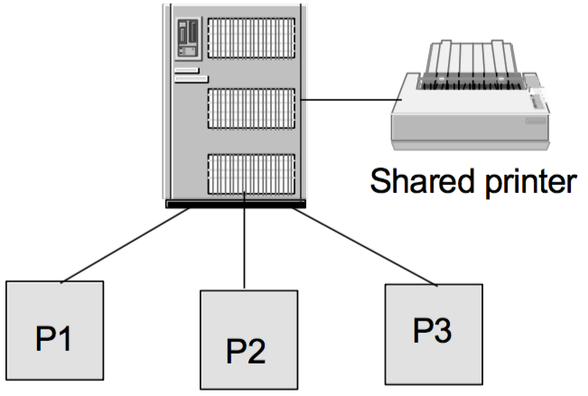
Lecture 4
Cooperating Processes
Critical Section, Semaphores
Borko Furht
Florida Atlantic University

Slide 2
Cooperating Processes
Cooperating processes affect or are affected by other processes executing in the system.
Cooperating processes may share a logical address space (both code and data) – lightweight processes or threads.
Cooperating processes can share only data through files.
Concurrent access to shared data may result in data inconsistency.

Slide 3
Example with Shared I/O

Slide 4
Mutual Exclusion
Each process accessing the shared data or shared I/O should exclude all other processes from doing it simultaneously.
Each process has a segment of code, critical section, in which the process can access the shared data or I/O.
When one process is in its critical section, all other processes, that access the same shared data, are excluded from their own critical sections.
Solutions: (a) software (b) hardware (c) OS.

Slide 5
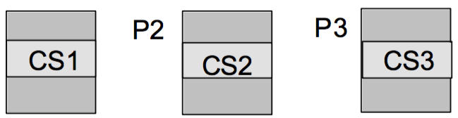
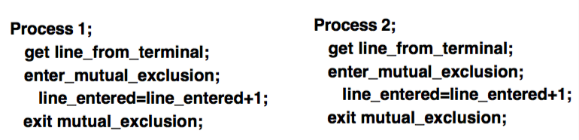
Solution of the Problem
P1
Note: similar problem in airline reservation systems.

Slide 6
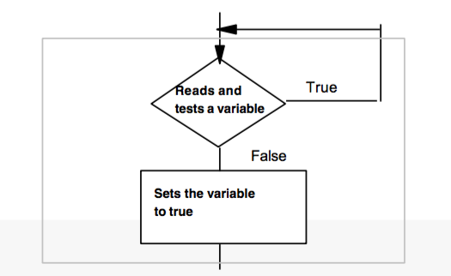
Synchronization Hardware
Solution for Mutual Exclusion
Test-and-Set instruction that:
1) Reads a variable and tests if true.
2) If the variable is true, it keeps testing the variable in a loop.
3) If the variable is false, it sets it to true and continues.

Slide 7
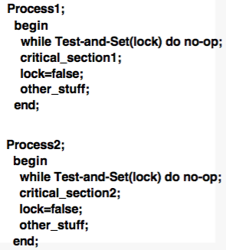
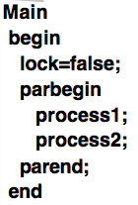
Mutual Exclusion with Test-and-Set Instruction

Slide 8
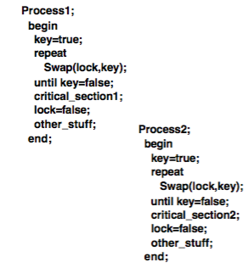
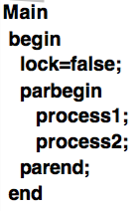
Mutual Exclusion with SWAP Instruction

Slide 9
Semaphores
Synchronization primitives to solve mutual exclusion problem.
A semaphore is a protected variable which can be accessed and altered by two operations P (or wait), and V (or signal).
Besides P and V, there is a semaphore initialization operation.
Binary semaphores bracket {0,1}
Counting semaphores - non-negative integers.

Slide 10
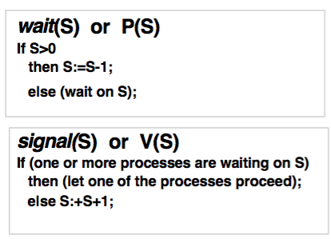
Semaphore Definitions

Slide 11
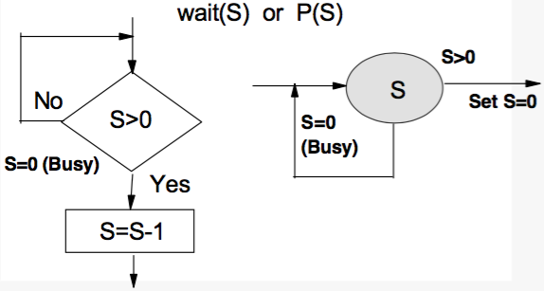
Semaphore Operations

Slide 12
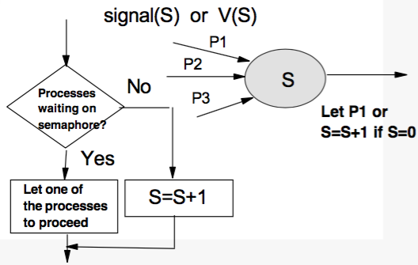
Semaphore Operations

Slide 13
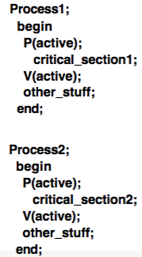
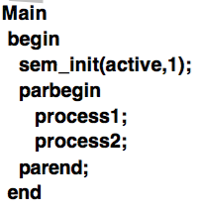
Mutual Exclusion with Semaphores

Slide 14
Process Synchronization

Slide 15
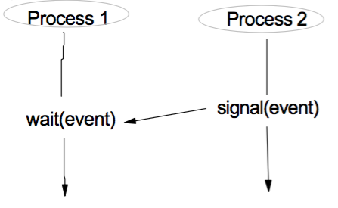
Process Synchronization with Semaphores

Slide 16
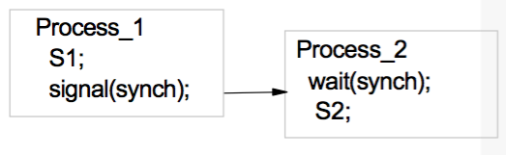
Examples of Process Synchronization
Instruction S2 in process 2 can be executed only when S1 is completed in process 1.

Slide 17
Semaphore Implementation
In the kernel-each semaphore has an integer value and the list (queue) of processes.
When a process must wait on the semaphore, it is added to the queue (wait operation). This process is blocked.
Signal operation removes one process from the queue of waiting processes, and puts it in the ready list.

Slide 18
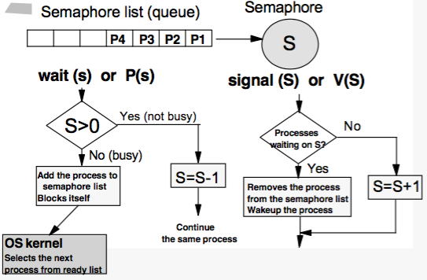
Semaphore Implementation - More

Slide 19
Semaphore List (Queue)
Implemented as a link list to processes’ PCBs.
Each semaphore contains an integer value and a point to at semaphore list.
Typically FIFO strategy is used for the semaphore queue scheduling.
In uniprocessor systems, during weight/signal operations, interrupts are disabled.
In multiprocessor systems: hardware support or software solution.

Slide 20
Spinlocks
Types of semaphores - specifically useful in multiprocessor systems.
Semaphores: when semaphore is busy, the process blocks itself and this requires a context switch.
When locks are expected to be held for short time (in multiprocessor systems) spin locks are useful.
Process spends while waiting for the lock, and there is no context switch.

Slide 21
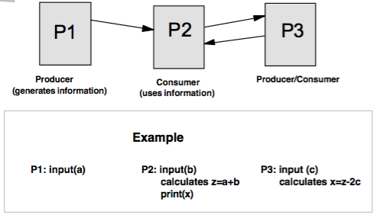
Producer-Consumer Relationship

Slide 22
Cooperating Programs for Previous Examples
P1: P2: P3:
Begin begin begin
input (a); input (b); input (c);
v(SI); p(SI); p(S2);
end; z=a+b; z x=z-2c;
v(S2); x v(S3);
p(S3); end;
print(x);
end;
a

Slide 23
Deadlock
When two or more processes are waiting indefinitely for an event that can be caused by only one of the waiting processes.
Example to processes with the following requirements for mutual exclusion.
P1: needs (R1 only)
needs (R1 & R2) P1
needs (R1 only)
P2: needs (R2 only)
needs (R1&R2) P2
needs (R2 only)

Slide 24
Solution
Critical point:
Both processes will wait indefinitely – P1 for R2 & P1 for R1
P1:
begin
p(S);
use (R1);
p(Q);
use (R1&R2);
v(Q);
use (R1);
v (S);
end;
P2:
begin
p(Q);
use (R2);
p(S);
use (R1&R2);
v(S);
use (R2);
v (Q);
end;

Slide 25
Producer/Consumer Problem
Producer inputs a value, calculates result, and deposit it as a common variable.
Consumer gets the common variable and outputs it.
Producer cannot deposit the next value before the previous was not used by the consumer.
Consumer cannot read the value before it was not deposited by the producer.

Slide 26
Flow Diagram of the Producer/Consumer Problem
Inputs a value and calculates and calculates result
Wait (access)
Wait (deposit)
Common
Variable
Consumer
Read the result and outputs
Producer
Deposit the result
Signal (deposit)
Signal (access)

Slide 27
Class Example
Synchronize three process: P1, P2, P3.
Process P1 inputs the d1 and calculates x=d1+d2.
Process P2 inputs d2 and calculates y=d1-d2.
Process P3 calculates z=x/y and prints z.

Slide 28
Counting Semaphores
The value of the semaphore is a non-negative integer (0,1,2,3…n).
Typical application – pool of identical common resources. Then n is equal to the number of common resources.
Semaphore value = 0 - semaphore is busy (all common resources are busy).
Semaphore value = i – semaphore is not busy (i common resources are available).
Semaphore is typically initialized to n- maxinmum number of available resources.

Slide 29
Example with Counting Semaphores
P1
P2
P3
Pj
….
R1
R2
R3
Identical common
resources

Slide 30
Problem with Counting Semaphores
There are 3 identical printers available that are accessed by many processes.
Write a program for a process which will access the printer.
Use counting semaphores to access the pool of printers and flags to specify when a printer is busy.

Slide 31
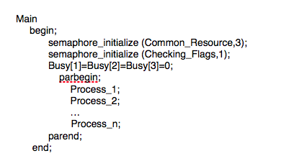
Solution

Slide 32
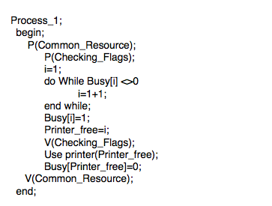
Solution - more

